Slide 1



Short Messages

Slide 2
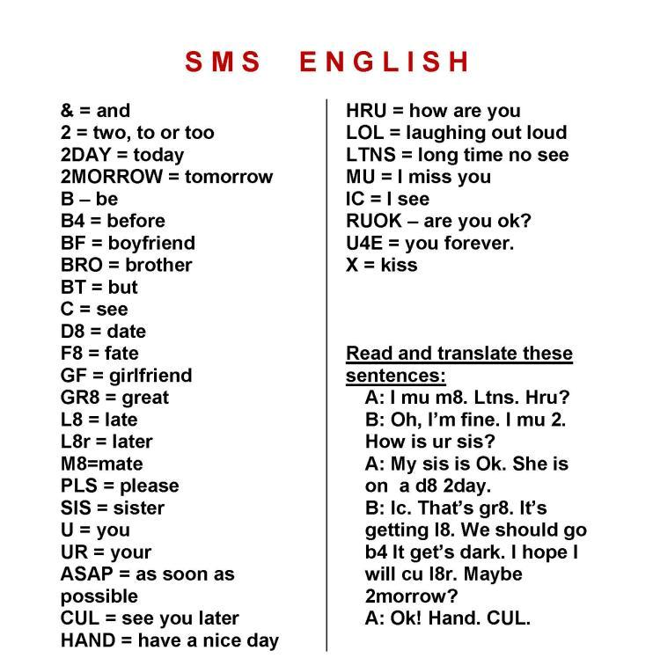

Slide 3
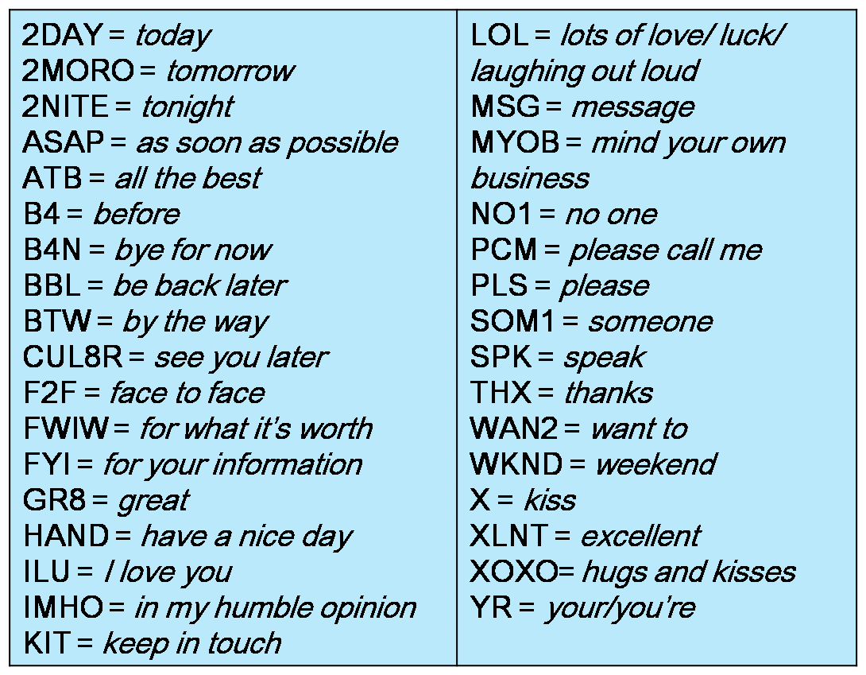

Slide 4
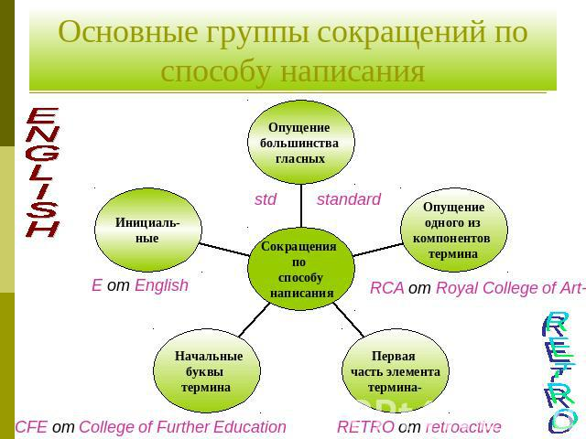

Slide 5
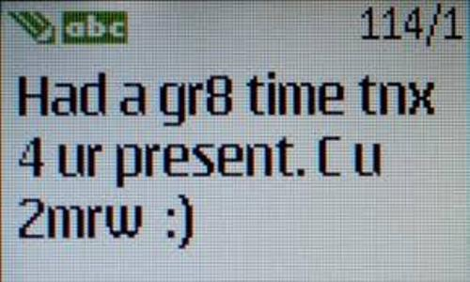


Slide 6
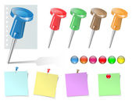

Guys
Fancy going to the Ballet tonight?
Starts at 6.30.
How about meeting near school at 6?
Why not go to park afterwards?
Hope you can come.
Phone me if you can’t make it.
Mrs Melnikova

Slide 7

Home task:
to write a reply to the classmate’s note

